Slide 1
Persistent problems in high throughput sequencing datasets (GLBIO 2024)
Greg Gloor
ggloor@uwo.ca
@gbgloor
@gbgloor.bluesky.social

Slide 2
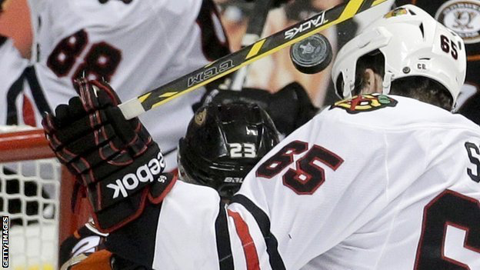
The goal
Given a high throughput sequencing dataset:
Identify what individual feature(s) associate with the difference between groups
Analyses should be internally and externally consistent
Analyses should be robust and reproducible
Notes:
Many more fragments than we can count

Slide 3
How we get our data
Reality
//
Measurement

Slide 4

Dark underbelly of HTS
General lack of robustness
Domain-specific tools
Why are all HTS data “different”?
Many researcher degrees of freedom
Dataset-specific workflows/analyses
Why do we use multiple approaches?
Instability in results
Why does sub-setting change outcomes?
Correlation!
Is there a general solution?

Slide 5



Our data in reality
Reality
Measurement

Slide 6
I’m not here today…
To say every analysis ever done was wrong …
But, every analysis ever done has a mismatch between the data that was collected and the underlying assumptions of basic statistics
We need to do better and to accept the limitations of the data
We need to acknowledge the issues and fix them

Slide 7
I am are here today…
To say every analysis ever done was wrong …
To say, every analysis ever done has a mismatch between the data that was collected and the underlying assumptions of basic statistics
To say we need to do better and to accept the limitations of the data and the tools
To say we need to acknowledge the issues and fix them
Notes:
Tools were developed for a different reality: SAGE – NGS or ecological surveys to NGS
Data was limiting and any info was a pearl

Slide 8
Precision or accuracy?

Slide 9
Why is good inference hard?
We don’t measure the moving parts directly
We want to measure the population but only have the composition
Gloor et al Front. Micro. 2017

Slide 10
Data as counts
Example 100 random sample sets
range=1800-2200
range= 8000-12000
range=450-550
🐯
🐞
👽
Gloor et al Front. Micro. 2017

Slide 11
As delivered by sequencing
Constant sum of 1000
Constant sum operations:
Library preparation
Mulitplexing
Sequencing
Count normalization
RLE, TMM, CSS, CLR, …
Rarefaction
Proportion, percentage, relative abundance
Simplex: one fewer dimensions than variables
Problems remain regardless of dimension
Subsetting the composition puts us on a different simplex
More dimensions make it “look OK” but it’s not
Gloor et al Front. Micro. 2017

Slide 12
Compositional operations ( )
Reality
Measurement

Slide 13
Log-ratios for CoDa
Count
Sequencing
Simplex
27
853
66
740
112
216
clr(x) = [ log(x₁/g_{X}), log(x₂/g_{X}), … log(x_{D}/g_{X}) ]
X = [ x₁, x₂, … x_{D} ], g_{X} = geometric mean of X
Hidden assumptions in x_{i} and in g_{X}!
Aitchison 1986. Stat. Anal. Comp Data
Pawlowsky-Glahn, 2015. Mod. Anal. CoDa
Notes:
Scale dependence - hence ‘normalization’
Correlation and covariation are unreliable
Addition and subtraction are not useful operations
Subsetting and aggregating are problematic
Sparse data is an issue

Slide 14
CLR is a poor approximation of the environment
The CLR is a point estimate
All other normalizations less interpretable
Nixon/Silverman show that CoDa/ sequencing is PID and that a full posterior model has less bias
From Gustafson 2015

Slide 15
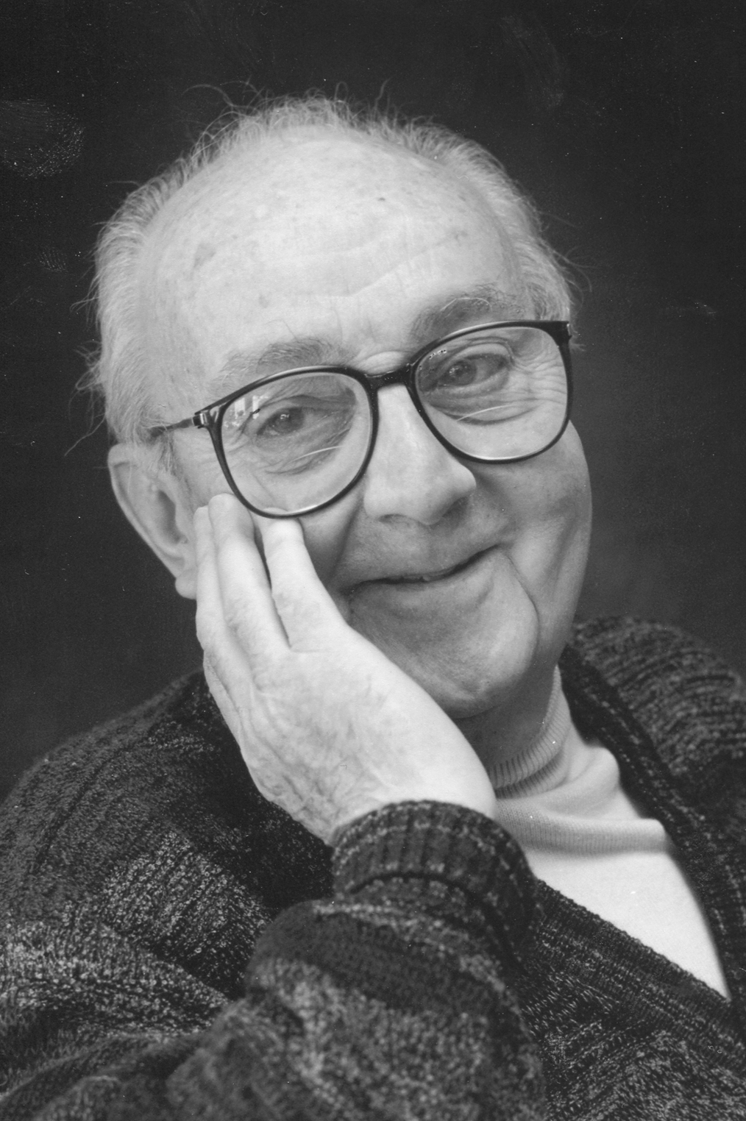
Box 1976-1977
All models are wrong, some models are useful
We are producing a less wrong model, that is more useful
Never underestimate the power of a simple sound bite!

Slide 16
clr(x) = [ log(x₁/g_{X}), log(x₂/g_{X}), … log(x_{D}/g_{X}) ]
Each x_{i} is a point estimate, as is g_{X}
Original ALDEx2 controlled for the excess precision of x_{i}
More data makes the numerator more accurate
This can be modelled
New ALDEx2 also controls for the denominator
More data has little effect on the denominator
Leads to inflated power problem in the transcriptome
Scale can fix this!
We need to acknowledge both as being flawed measures

Slide 17
ALDEx2 (original): probabilistic CoDa
Group 1 Group 2
Generate posterior estimates of the data consistent with the observed data and the chosen prior(s)
Dirichlet instances
lr transform instances
Calculate test values on each instance
Correct for FDR
Report the expected value of each test for all genes
Dramatically reduces false positives with little or no loss of sensitivity for essentially any seq*omics dataset
Fernandes, et al. 2013. PLoS ONE
Fernandes, et al. 2014. Microbiome
Thorsen, Microbiome 2016
Notes:
Many more fragments than we can count

Slide 18
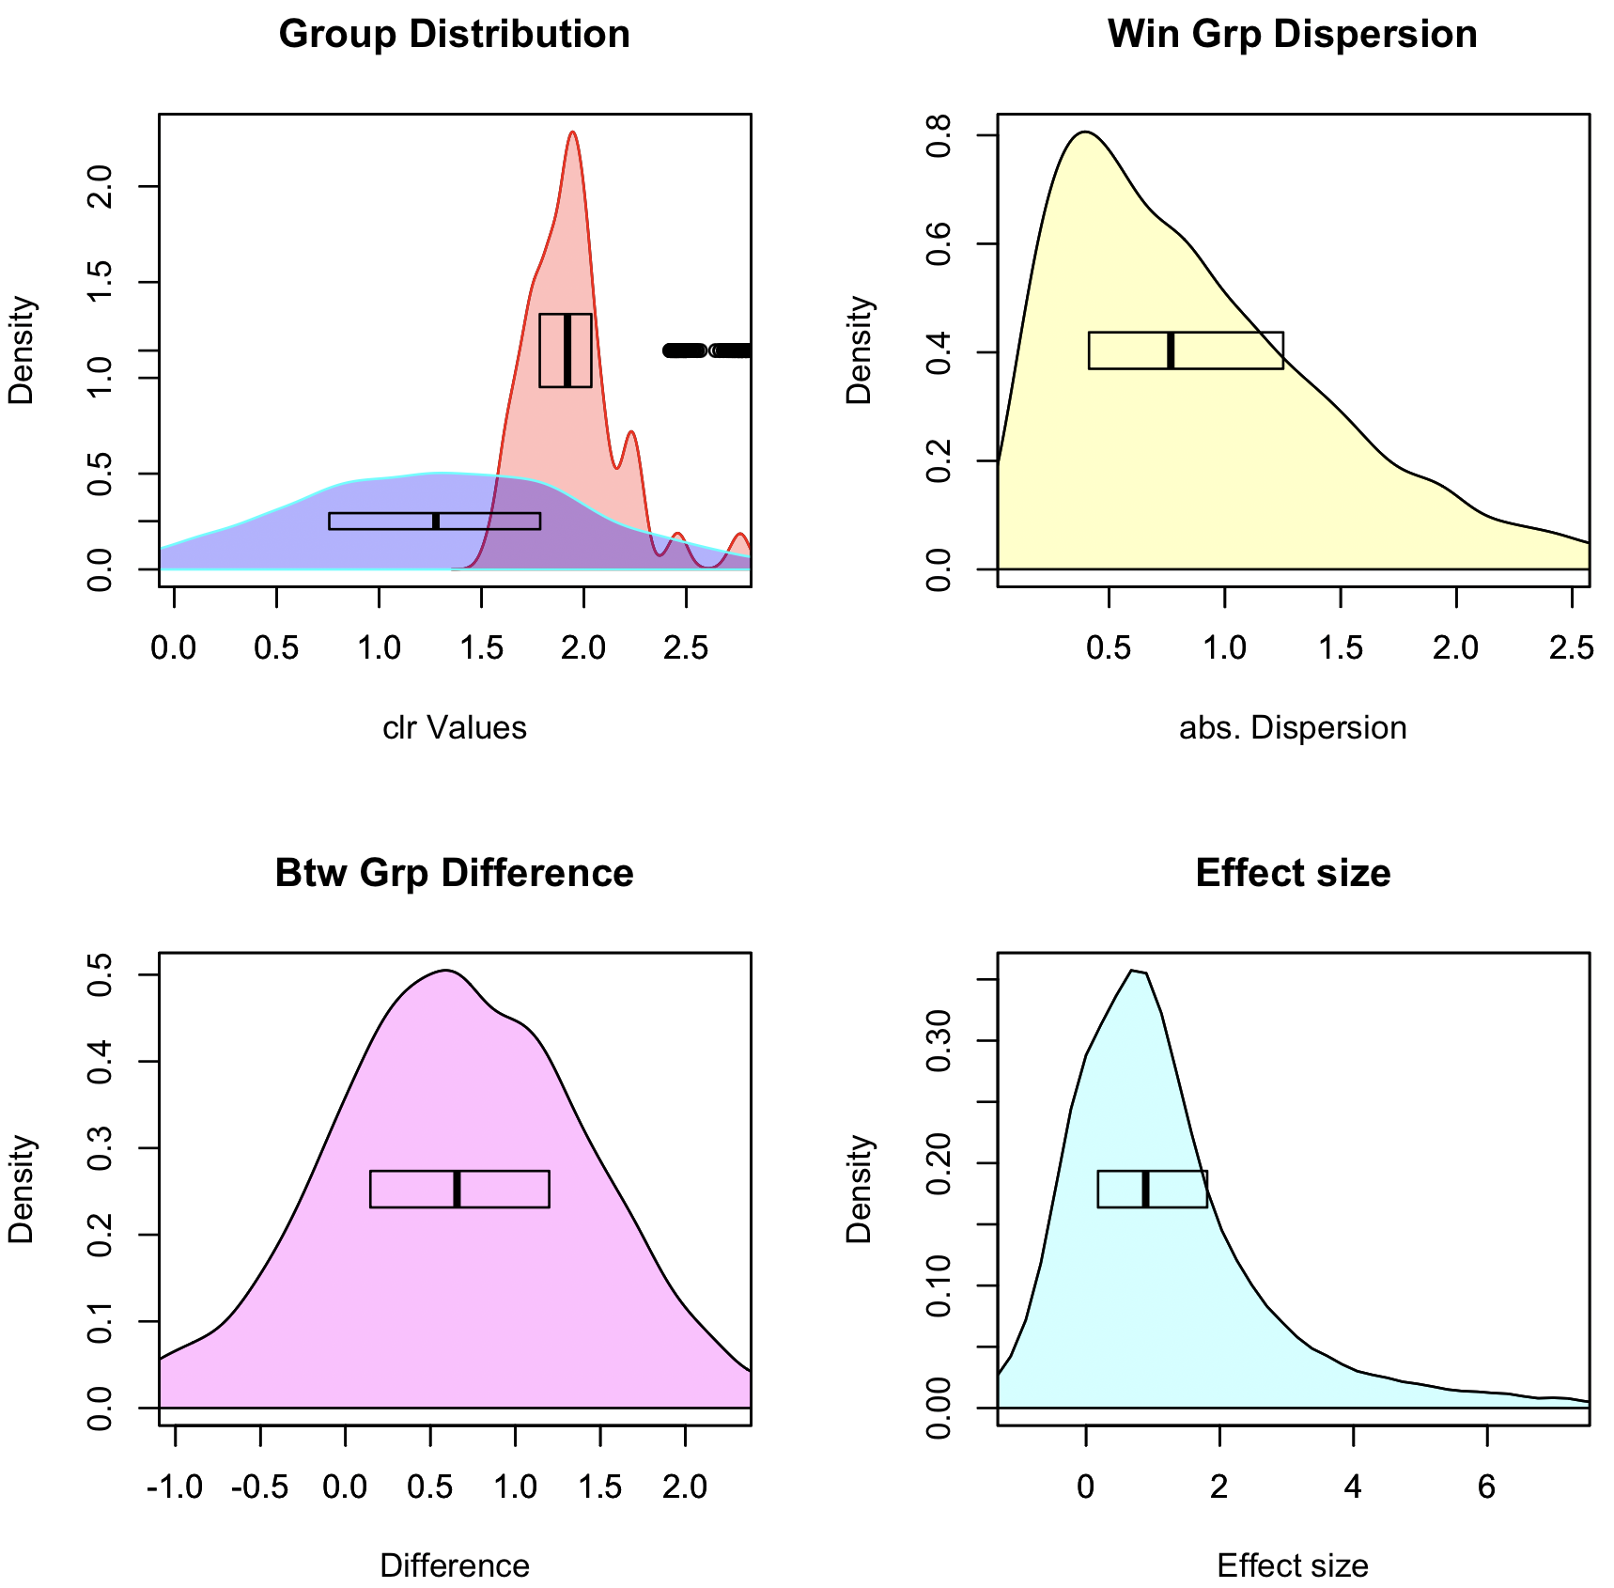
Graphical intuition ( aldex.plotFeature() )
Point and posterior distributions (rab.A, rab.B)
Pooled dispersion: diff.win
Pooled difference: diff.btw
Pooled Effect: effect

Slide 19
What is bad data?
Assumptions of all tools and normalizations
Very few DA features
DA is symmetric or at least stochastic
Equal underlying environmental abundance
High quality transcriptomes and single cell (sometimes)
The reality
Many DA features
Asymmetric data
Different environment sizes
Just about Everything else

Slide 20
Diagnosing bad data
Too many things ‘significant’
Something must be invariant
q-score is unrealistic
Mismatch between model and test
Too much ‘power’ for sample size
No real variation
Many parts have 0 variance
Asymmetry
Few features on the line of no difference
Even ’good data’ can actually be bad!

Slide 21
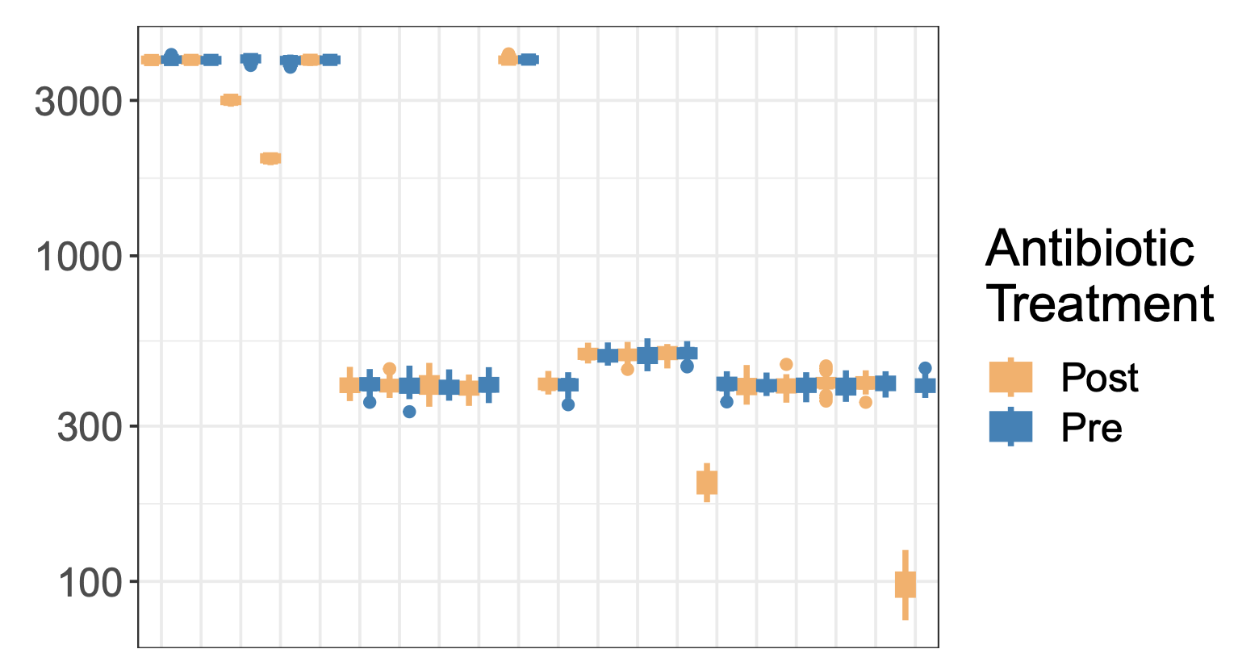
Example 1: mock chemostat
Model chemostat experiment
Expect unidirectional change in a small number of taxa
Mis-estimation of scale by clr causes issues for compositional systems
Unacknowledged bias in specifying scale causes commonly observed analysis artefacts
Nixon et al, ArXiv https://arxiv.org/pdf/2201.03616

Slide 22
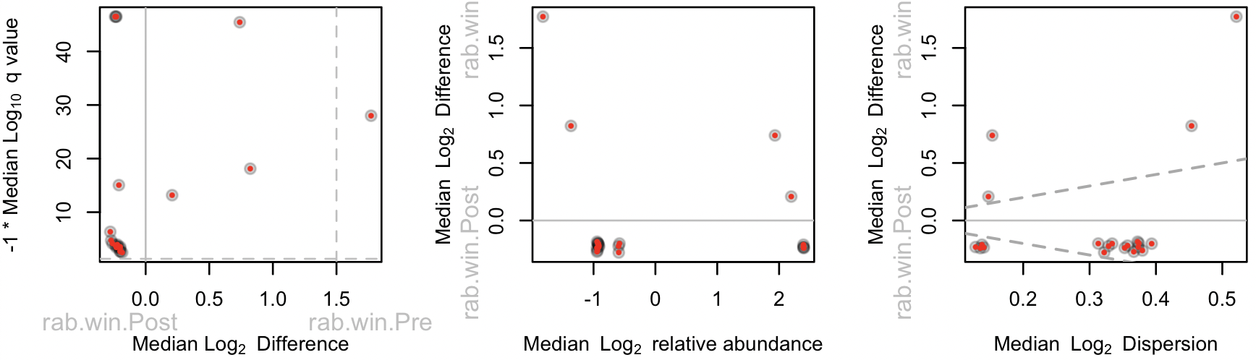
Identification: Plot your data

Slide 23
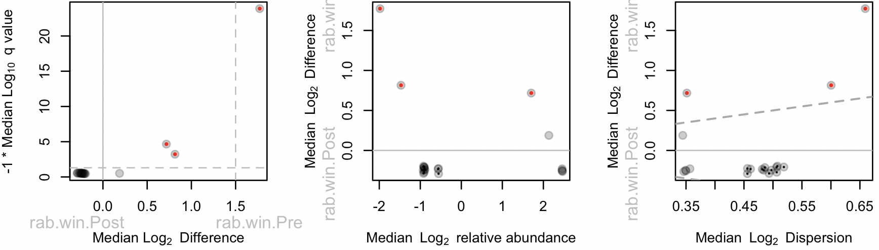
Add just a smidgen of scale (0.25)

Slide 24
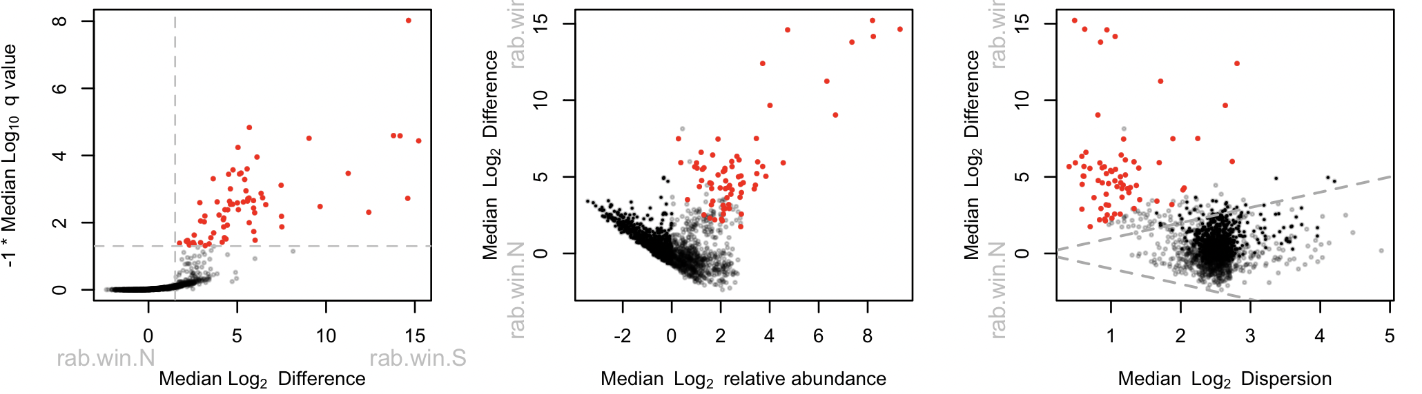
Example 2: selex
Less effect in this dataset
Uni-directional change
Standard of truth
McMurrouggh et al, NAR 2018

Slide 25
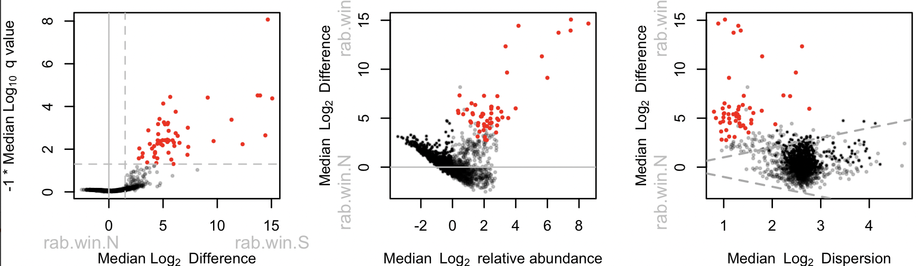
Example 2: selex (0.5)
Uni-directional change
Standard of truth

Slide 26
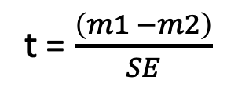
Root of inflated power issue:
t = $\frac{\left(m1 −m2\right)}{SE}$
2 ways to get a high t and low p-value
1 - ?
2 - ?
Anders et al, Genome Biology 2010

Slide 27
Dispersion vs. count
t = $\frac{\left(m1 −m2\right)}{SE}$
2 ways to get a high t and low p-value
1 – big difference
2 - low SE (variance)
Which is most likely to be useful and correct?

Slide 28
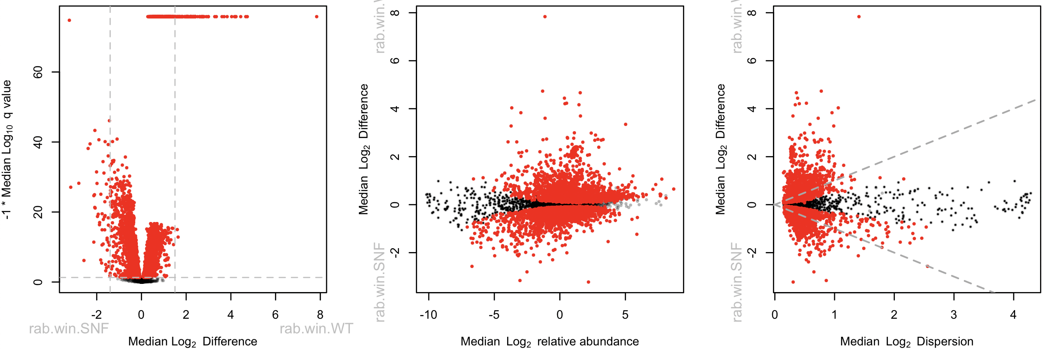
Example 3: yeast transcriptome
Highly replicated yeast transcriptome (>2/3)
We apply a 1.4-fold cutoff (3.1%)
Schurch et al, RNA 2016

Slide 29
Example 3: yeast transcriptome
Highly replicated yeast transcriptome (>2/3)
We apply a 1.4-fold cutoff (3.1%)
Schurch et al, RNA 2016

Slide 30
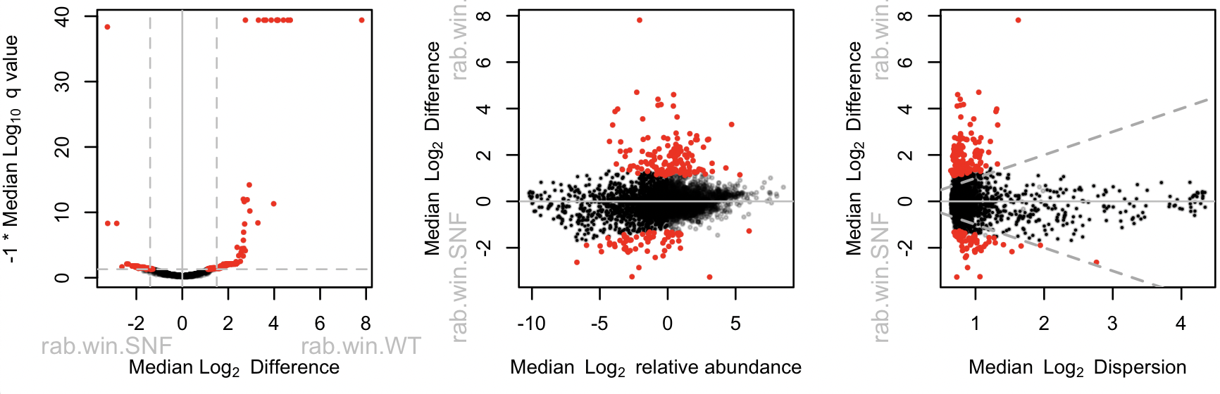
Example 3: yeast transcriptome (+0.5)
Highly replicated yeast t’scome (4%)

Slide 31
Example 4: meta-transcriptome
Worst of the worst
BV v H metatranscriptome dataset
Scale misspecification at play here
H / BV bacterial load ~ 1/10 – 1/100
- bulk scale ~8X
- housekeeping scale ~1.15X
See Dos Santoa et al, BiorXiv 10.1101/2024.04.24.590967v2 2024

Slide 32
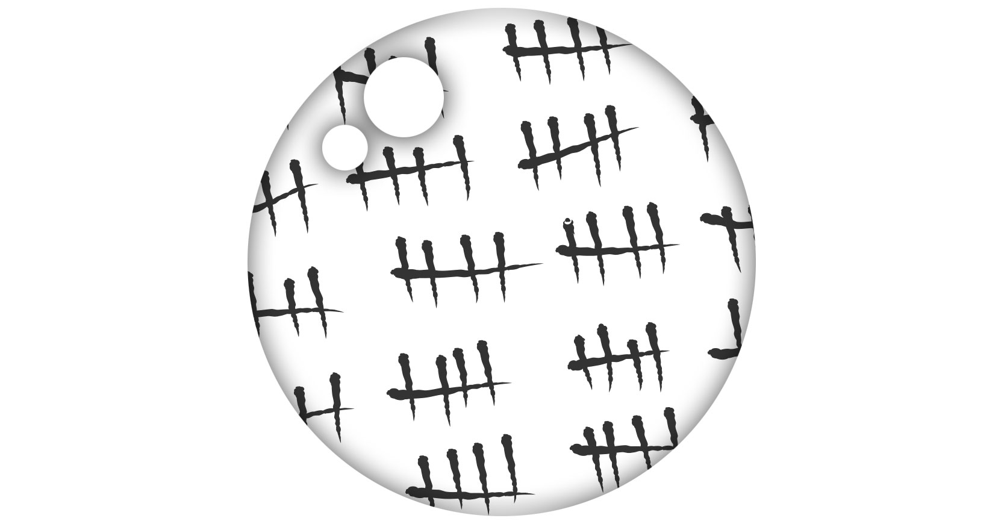
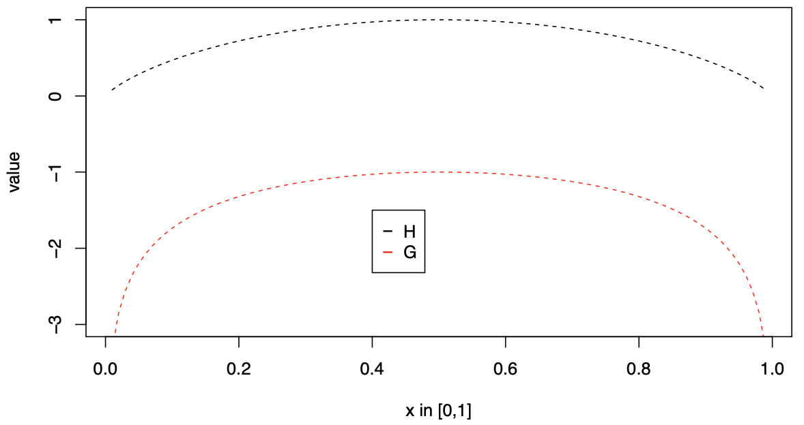
What is scale?
Known counts (external data added)
Data from cell counting
Data from spike-in controls (but …)
Data from abundance measures
…
Information (internal data only)
log₂(1/G(Y∥_{.n})) = -log₂(G(Y∥_{.n})) = h₂(Y∥_{.n})
Expected Information (Shannon)
log₂(G(Y∥_{.n})) ≅ H₂(Y∥_{.n}) + C + 𝛖
Substitutable!
Entropy interpreted as volume or size in QIT
Nixon et al, ArXiv https://arxiv.org/pdf/2201.03616 2023
Gloor et al, BiorXiv 2024.04.01.587602 2024

Slide 33


Summary
HTS data are partially identifiable:
Scale is assumed, wrongly, by all tools to be estimated properly
Causes false precision and false confidence in the inference
Accounting for scale prevents shrinking to a known wrong estimate
Better inference is obtained if all parameters are estimated including scale
As a minimum can determine what is robust to scale uncertainty
D – uncertainty and skepticisbe your default state

Slide 34
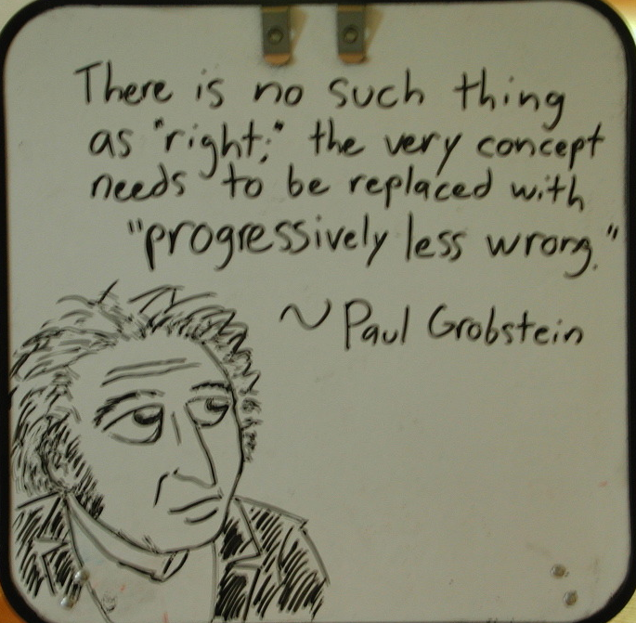
Summary
Uncertainty is not a bad thing:
A – your data are uncertain
B – therefore the results are uncertain
C – therefore your interpretation must allow for uncertainty
D - ‘Biological systems’ are only as different as they need to be (Jussi Taipale)

Slide 35
Up next
Michelle Nixon
Explicit description of scale
How it is integrated into ALDEx2
The amazing increases in sensitivity and specificity that are possible
Tips on how to model scale
Kyle McGovern
Taking it to the next level
Using scale in GSEA and differential set analysis
Shows scale is a general approach

